Slide 1
Project Update: 10/30/19
Kaleb Tsegaye

Slide 2
Overview
A program for parsing concert/live performance data
Provided an artist name, dates and/or genre, can plot artist’s tour path, venues/cities/states where given genre is the highest proportion

Slide 3
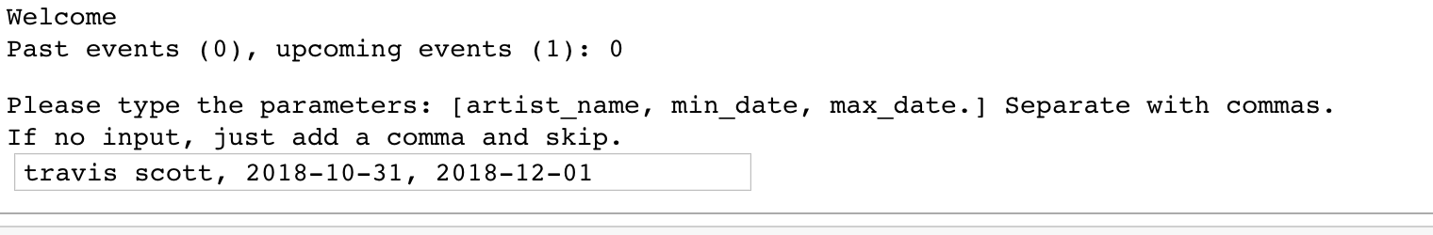
Functions
Req_input: provides the interface to make queries to the API

Slide 4
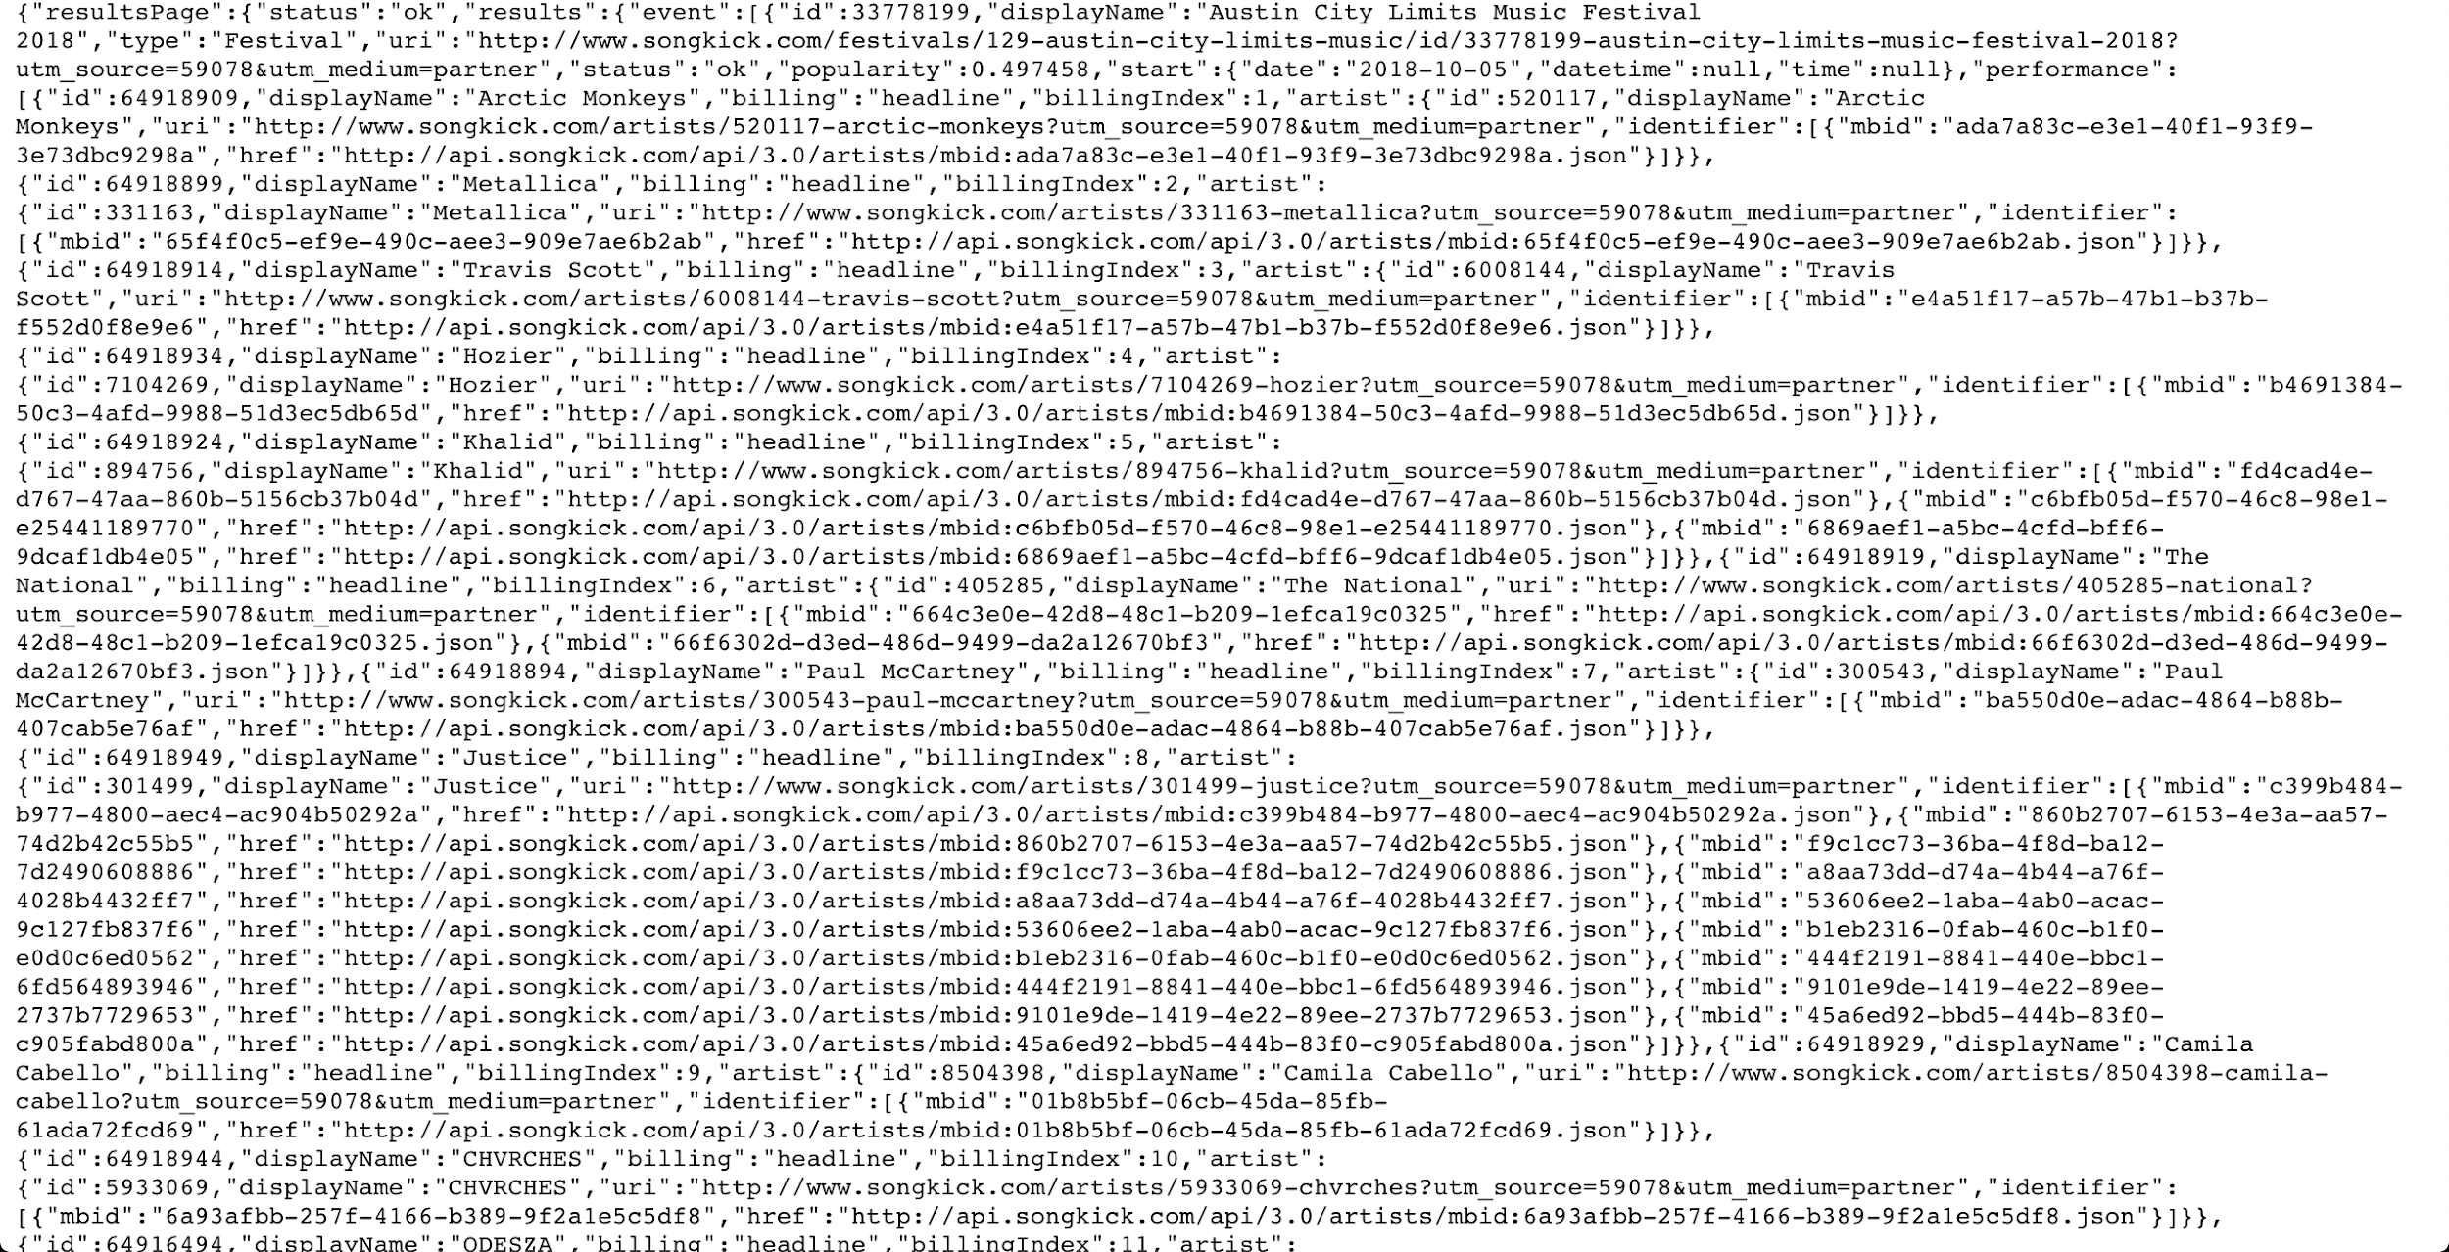
Functions
Make_points: parse the API query to compile geodataframe of points for plotting

Slide 5
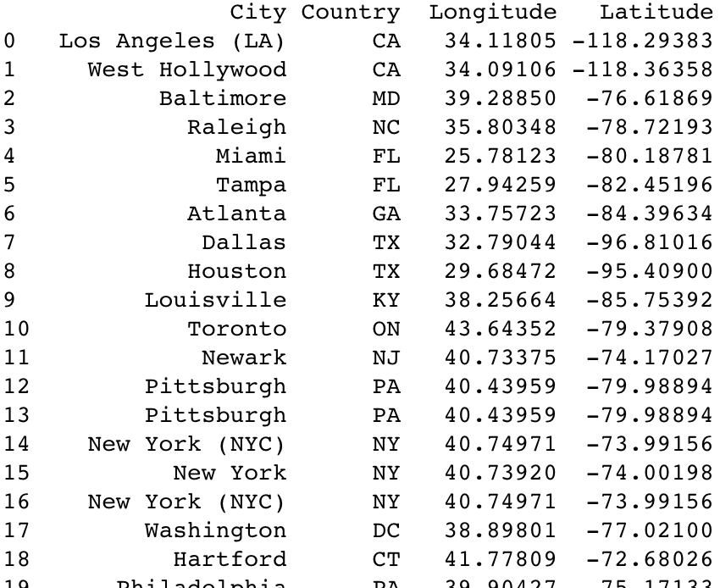

Slide 6
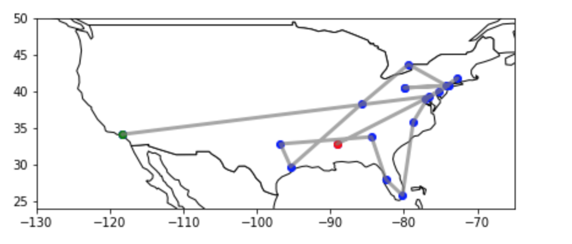
Functions
Run_plot: plots data provided by make_points

Slide 7
Challenges
Previously mentioned challenges:
Rate-limiting - not an issue (for now)
Data - good for US/European artists, includes concerts outside of US/Europe
Can’t query by tour name

Slide 8
Next Steps
Incorporation of Spotify API - functions for finding artists of certain popularity/genre, returning given artist genre
Analysis of lesser-known artists to find most frequented cities/venues
Improving overall quality of plots, interface for taking input

